Slide 1
Movie Recommendation System

Slide 2
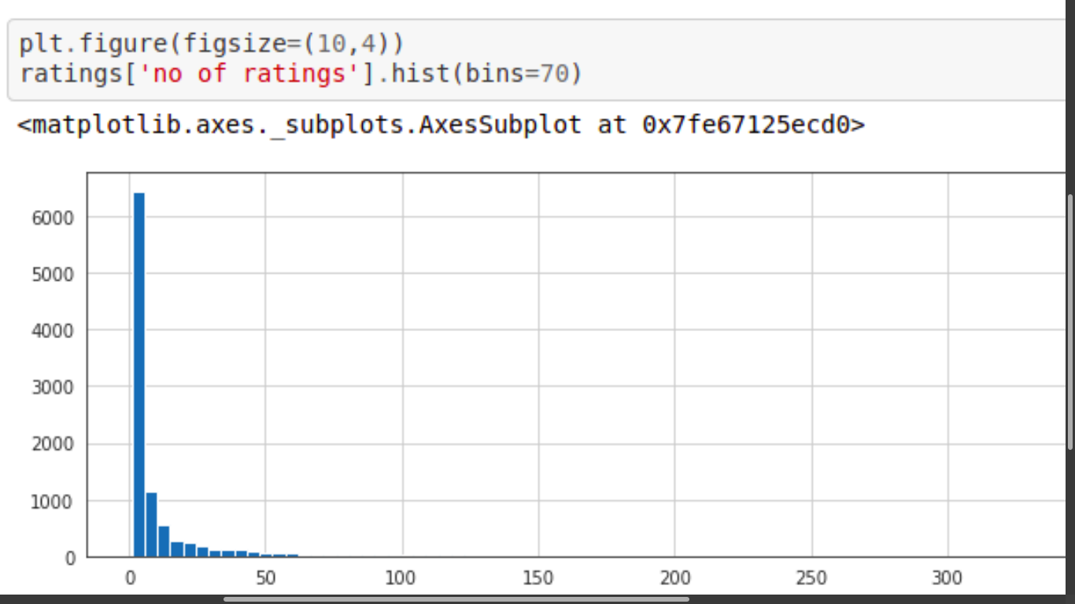
Relation betwen no. of ratings to number of movies (Histogram)

Slide 3
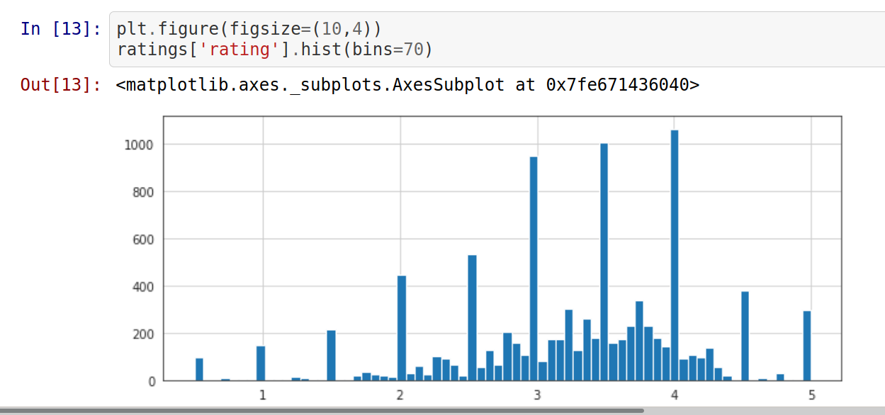
Relation between no. of ratings to ratings given by people (Histogram)

Slide 4
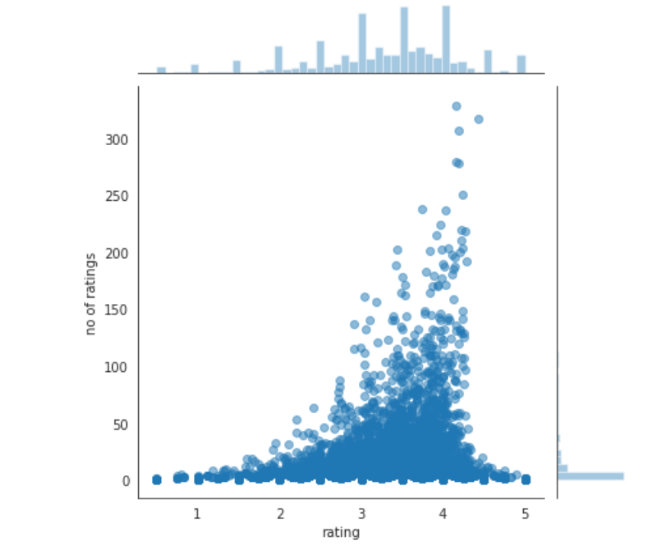
Relation between ratings to no. of ratings (Joinplot)

Slide 5
Conclusion and future directions
●Built useful models to predict movies based on peoples ratings
●Accuracy of the models has room for improvement
●Capture more data of movies and people ratings

